Slide 1


Data Analytics

Slide 2


Today's agenda
Project recap
Problem
The Analytics team
Process
Insights
Summary

Slide 3

Business data analytics involves the process of examining large sets of data to uncover insights, trends, and patterns that can help businesses make informed decisions and improve performance. It encompasses various techniques such as statistical analysis, data mining, predictive modeling, and machine learning to extract valuable insights from data sources like sales figures, customer demographics, website traffic, and social media interactions. By leveraging data analytics, businesses can optimize operations, enhance marketing strategies, improve customer satisfaction, and ultimately drive growth and profitability.
Business data analytics involves the process of examining large sets of data to uncover insights, trends, and patterns that can help businesses make informed decisions and improve performance. It encompasses various techniques such as statistical analysis, data mining, predictive modeling, and machine learning to extract valuable insights from data sources like sales figures, customer demographics, website traffic, and social media interactions. By leveraging data analytics, businesses can optimize operations, enhance marketing strategies, improve customer satisfaction, and ultimately drive growth and profitability.
Business data analytics involves the process of examining large sets of data to uncover insights, trends, and patterns that can help businesses make informed decisions and improve performance. It encompasses various techniques such as statistical analysis, data mining, predictive modeling, and machine learning to extract valuable insights from data sources like sales figures, customer demographics, website traffic, and social media interactions. By leveraging data analytics, businesses can optimize operations, enhance marketing strategies, improve customer satisfaction, and ultimately drive growth and profitability.
Some ey Points regarding Data Analytics:
Decision Making: Data analytics enables informed decision-making.
Performance Optimization: Identifies inefficiencies and enhances productivity.
Customer Insights: Understands customer behavior for personalized strategies.
Predictive Analytics: Forecasts trends and mitigates risks.
Competitive Advantage: Drives innovation and market leadership.
Data-driven Culture: Fosters innovation and continuous improvement.
Project Recap

Slide 4

Problem
Over several amount data received in an interval of time
Lacs od data values receive
But how to capitalize on it when there is so much ?
How to manage the data in graph format?

Slide 5
Process
1
Decision Making
2
Data Cleaning
3
Data Modeling
4
Data Analysis
5
Uncover Insights

Slide 6
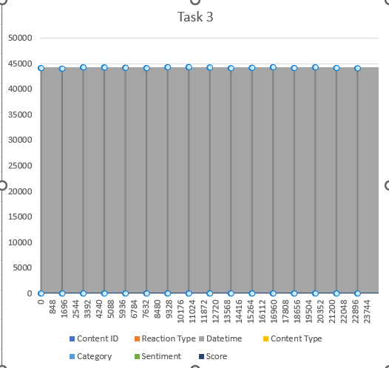

Slide 7


In this Project we have first cleaned the data and then processed it.
Summary

Slide 8
Thank you!
ANY QUESTIONS?

